Slide 1
Email Template P70-Team -5
YatHish AL

Slide 2
Approach
Web Scraping.
Dataset details.
EDA (Preprocessing).
Model Building.
Model Evaluation.
Deployment.

Slide 3
Objective
To get the nearest email template required by the user based on the key words specified by the user.
Dataset details
Scrapping most used email templates from websites data set size is subjective to individual team and to the NLP model requirement.
URL=https://blog.polymail.io/post/cold-email-templates-follow-up-cadence-examples.

Slide 4
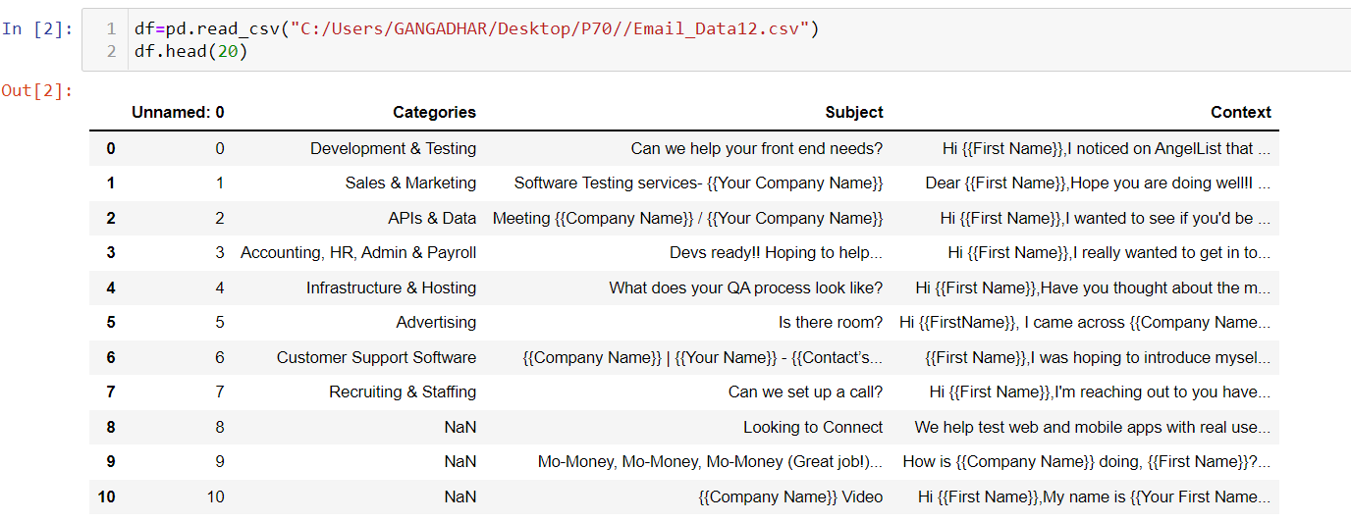
Dataset details
This is the data which is extracted from the website using Web Scraping.

Slide 5
EDA
Text Preprocessing in Natural Language Processing
The various text preprocessing steps are:
Tokenization
Lower casing
Stop words removal
Stemming
Lemmatization.

Slide 6
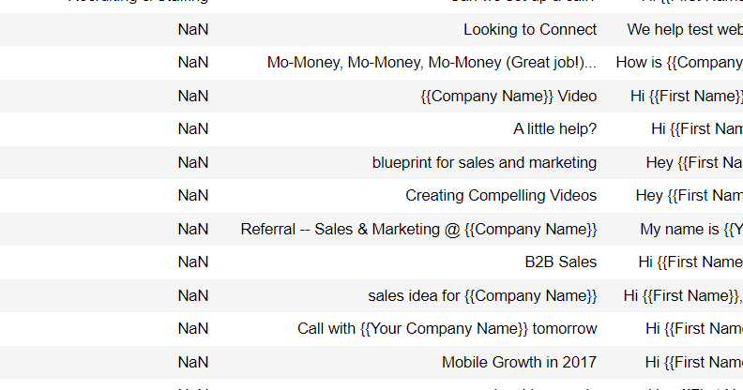
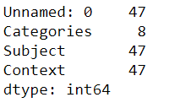
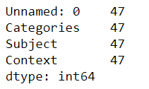
Filling Null values
Count of Null Values before Filling null values
Count of Null Values after Filling null values
Initially after getting the data we got the null values in the columns so we replaced it by the previous value.

Slide 7
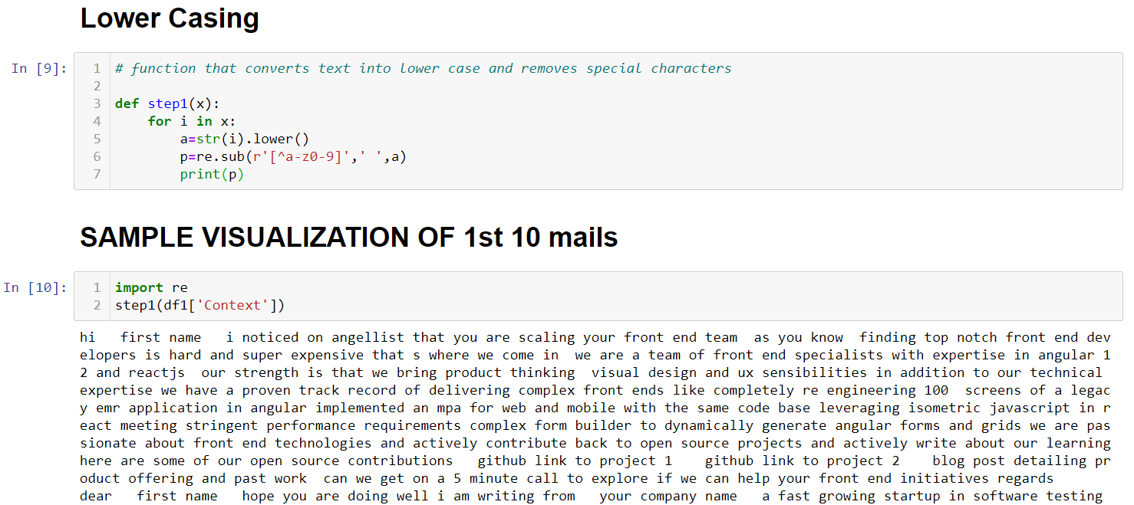
Lower Casing
Words like Name and name mean the same but when not converted to the lower case those two are represented as two different words in the vector space model (resulting in more dimensions).
This might lead to decline in the accuracy. So we go with Lower Casing

Slide 8
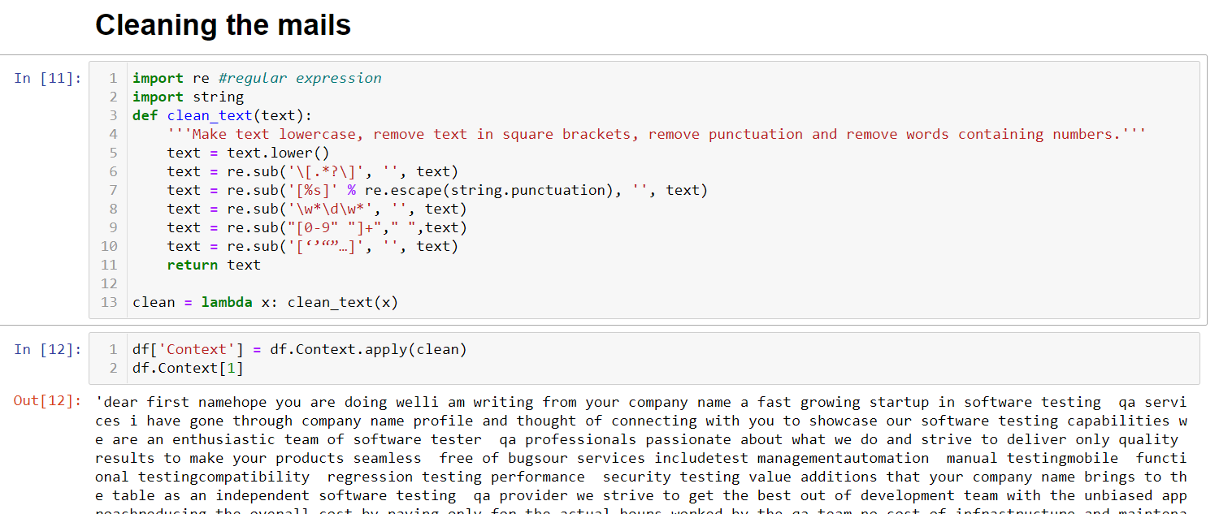
Cleaning the mails
As said we clean these square brackets, punctuation and removal of words containing numbers so as to build the model accuracy as well as so that machine learning algorithms can perform better.

Slide 9
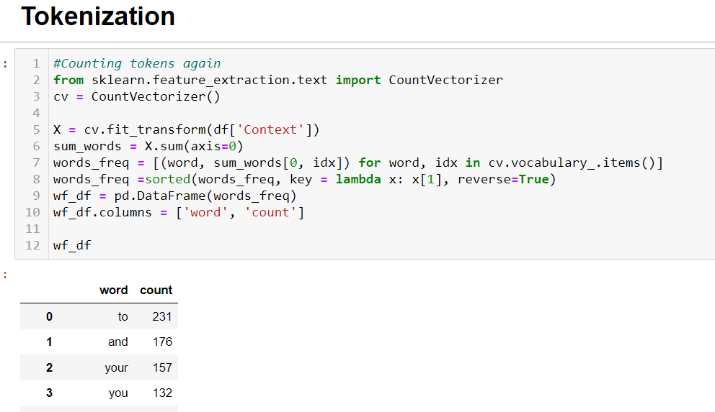
Tokenization
Here we perform Tokeization. tokenizing strings and giving an integer id for each possible token, for instance by using white-spaces and punctuation as token separators.
This specific strategy (tokenization, counting and normalization) is called the Bag of Words or “Bag of n-grams” representation.
An N-gram language model predicts the probability of a given N-gram within any sequence of words in the language.

Slide 10
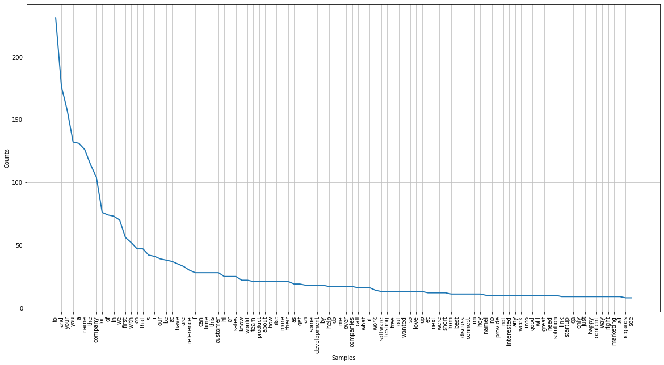
Word Count

Slide 11
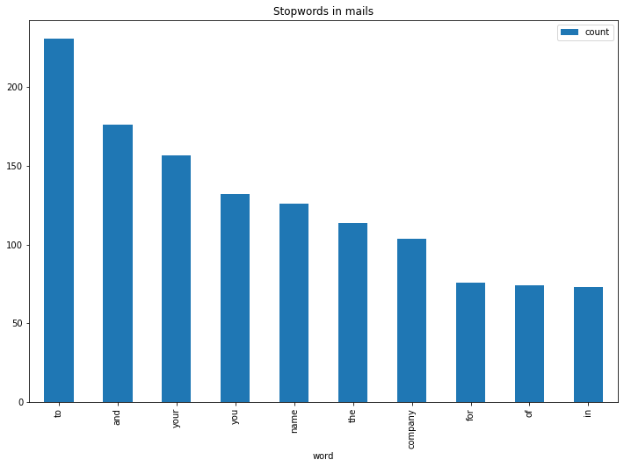
Wordstop

Slide 12
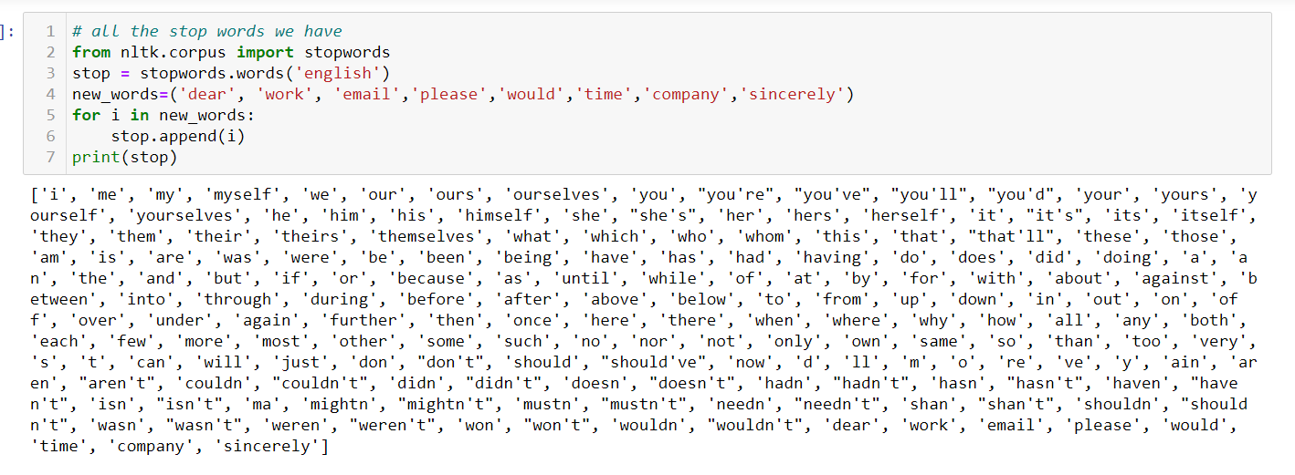
Stop Word
Removing these words helps the model to consider only key features. These words also don't carry much information. By eliminating them, we can focus on the important words.

Slide 13
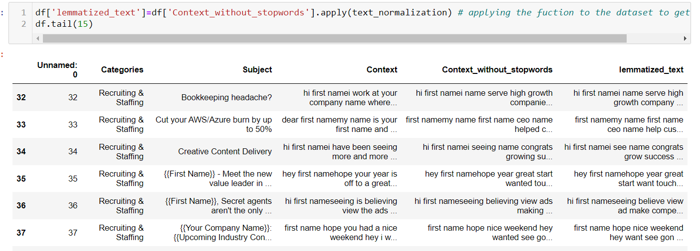
Lemmatization
This method switches any kind of a word to its base root mode.
This is done so as to do more of processing / fast processing.
Lemmatization is used so as to do the retrieval of information.

Slide 14
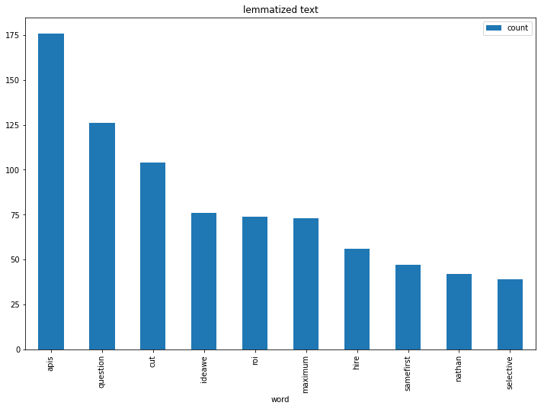
WordCount after Lemmatization

Slide 15
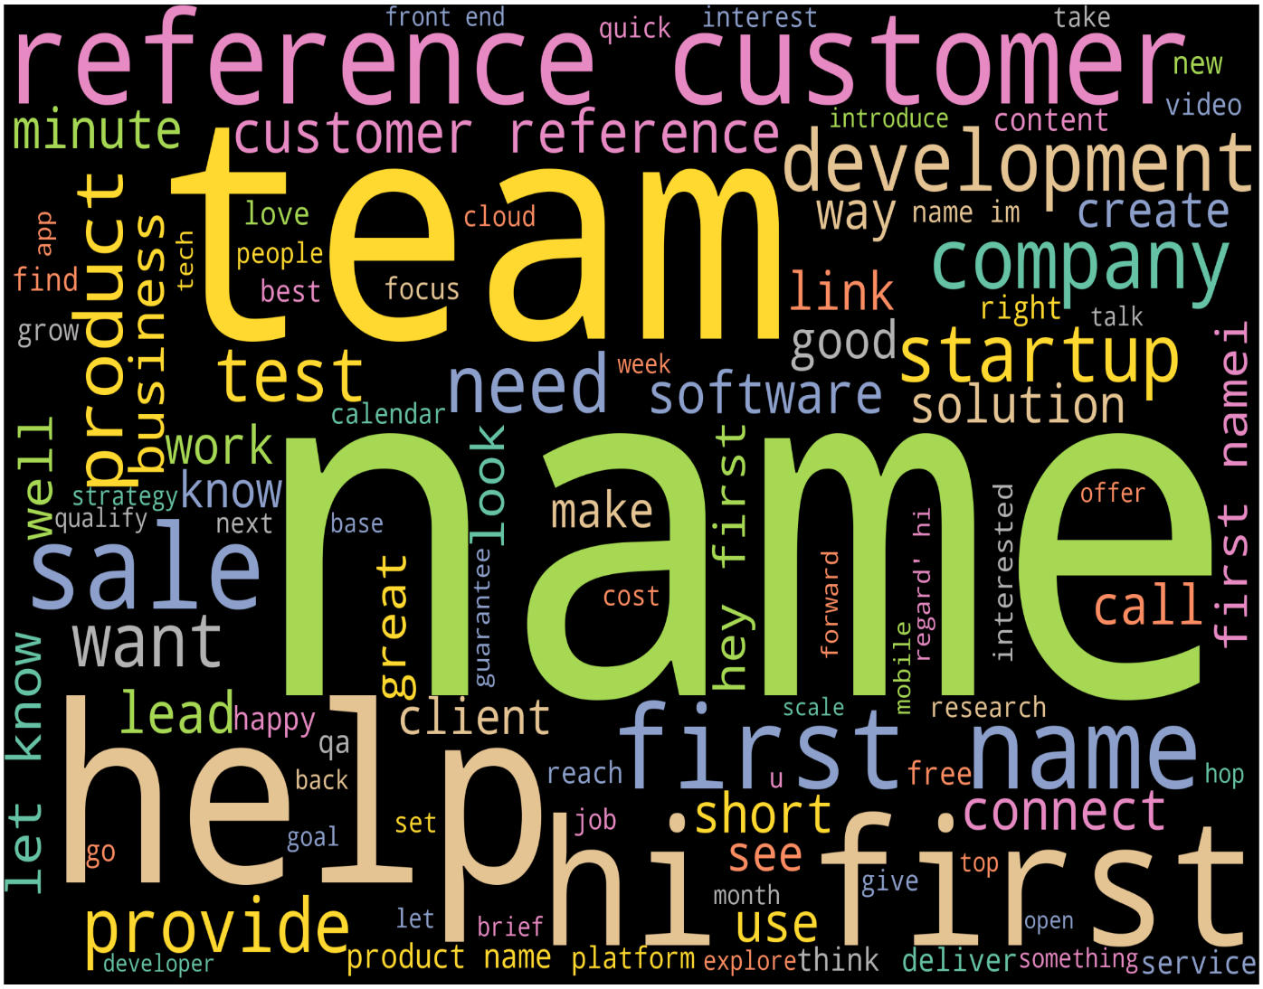
Frequency of words after Lemmatization -Word Cloud
A frequency distribution records the number of times each outcome of an experiment has occurred.

Slide 16
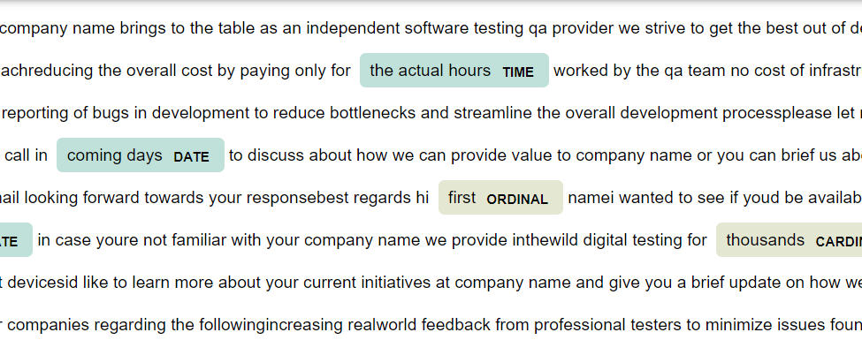
Named Entity Recognition
Named entity recognition helps you easily identify the key elements in a text, like names of people, places, brands, monetary values, and more. Extracting the main entities in a text helps sort unstructured data and detect important information.
It will help us to recognize key words in the data set.

Slide 17
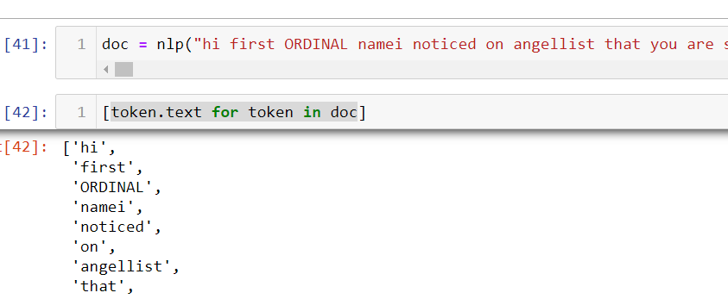
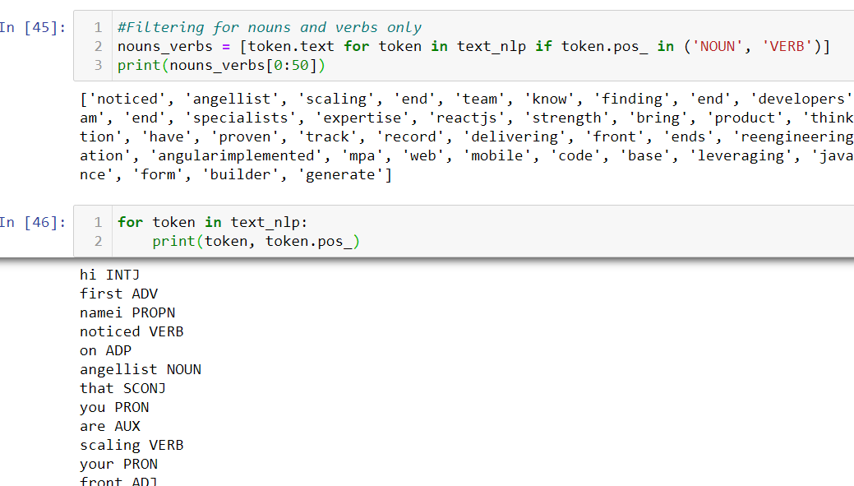
Parts Of Speech Tagging
They provide linguistic signal on how a word is being used within the scope of a phrase, sentence,or document which explains the definition of sense or meaning of the word.

Slide 18
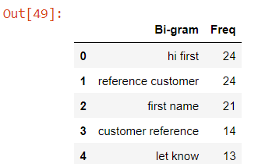
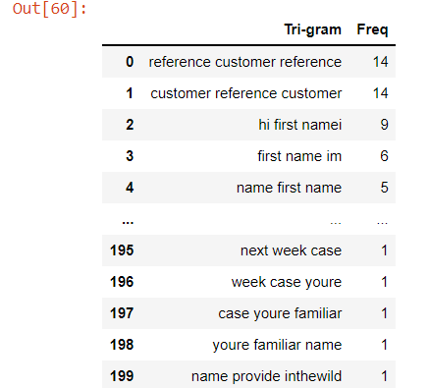
Bigram and Trigram Analysis
*This can be used in statistical findings on the frequency of such pairs in a given text. That will corelate to the general sentiment of the descriptions present int he body of the text.
*First, we need to generate such word pairs from the existing sentence maintain their current sequences. Such pairs are called Bigrams and Trigrams.
The Bigram and Trigram language model predicts the probability of a given N-gram within any sequence of words in the language.
This will help us to know the next occurance and auto fill.

Slide 19
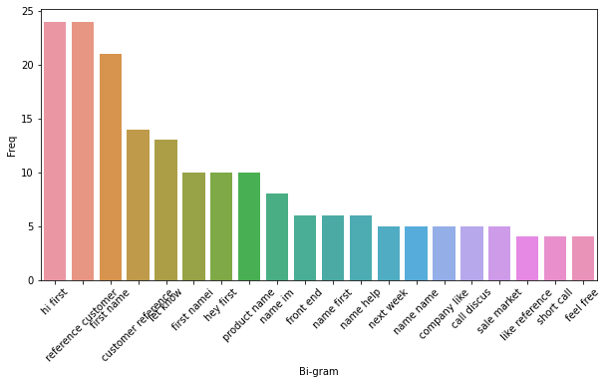
Bigram Visualization

Slide 20
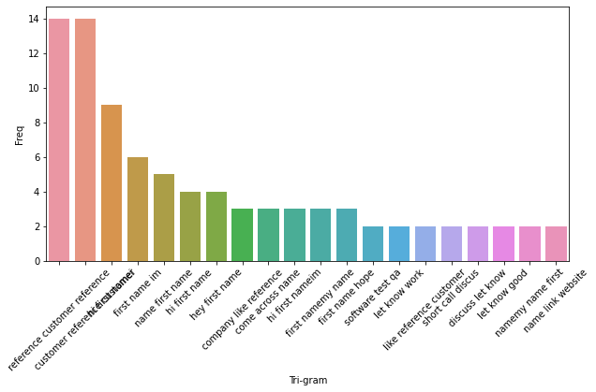
Trigram Visualization

Slide 21
MODEL BUILDING

